Slide 1




Legal Update
SHRM Montgomery
January 15, 2026
Presented By:
Matt Stiles
mstiles@maynardnexsen.com

Slide 2
AGENDA
The Trump Labor & Employment Agenda Taking Shape
One Big Beautiful Bill Act (OB3)
Federal Contractor Update
Recent Employee Benefits Developments

Slide 3
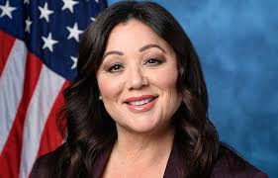
Meet the new boss- same as the old boss
Labor Secretary Lori Chavez-DeRemer has maintained DOL’s audit and investigative functions much the same as the Biden Era DOL
Exploited Worker Enforcement
Wage and Hour Audits
Benefits Compliance Audits – with focus on fiduciary duties

Slide 4
EMPLOYMENT INITIATIVES & LEGISLATION
Independent Contractor Pendulum Swing
  Reversal of Biden DOL’s rule against independent contractors
  Revival of Trump 1.0 independent contractor rule
  Not likely to change how courts and state agencies view the issues
  If you use an independent contractor, what evidence do you have that they are truly in business for themselves and not economically reliant on you?

Slide 5
EMPLOYMENT INITIATIVES & LEGISLATION
Federal Trade Commission’s Non-Compete Rule
  FTC’s attempts to prohibit non-compete agreements nationwide was enjoined by a federal court on August 20, 2024
  Biden FTC appealed the decision
  On September 5, 2025, the Trump FTC voted 3-1 to withdraw its appeal in the case, terminating the non-compete rule
  States continue to crack down on use of non-competes: Arkansas, Louisiana, Maryland, Pennsylvania, Virginia, and Wyoming all of have new non-compete restrictions in 2025

Slide 6
EMPLOYMENT INITIATIVES & LEGISLATION
Diversity Equity & Inclusion
  The EEOC operates as an independent agency
  Obtained a quorum last October, with two Republican members and one Democrat (two pending vacancies)
  Department of Justice has some overlapping authority to enforce federal civil rights law, and a second Trump Administration has so far aggressively utilized DOJ to pursue discriminatory DEI programs
  It continues to be the “E” in most DE&I programs that employers need to scrutinize

Slide 7

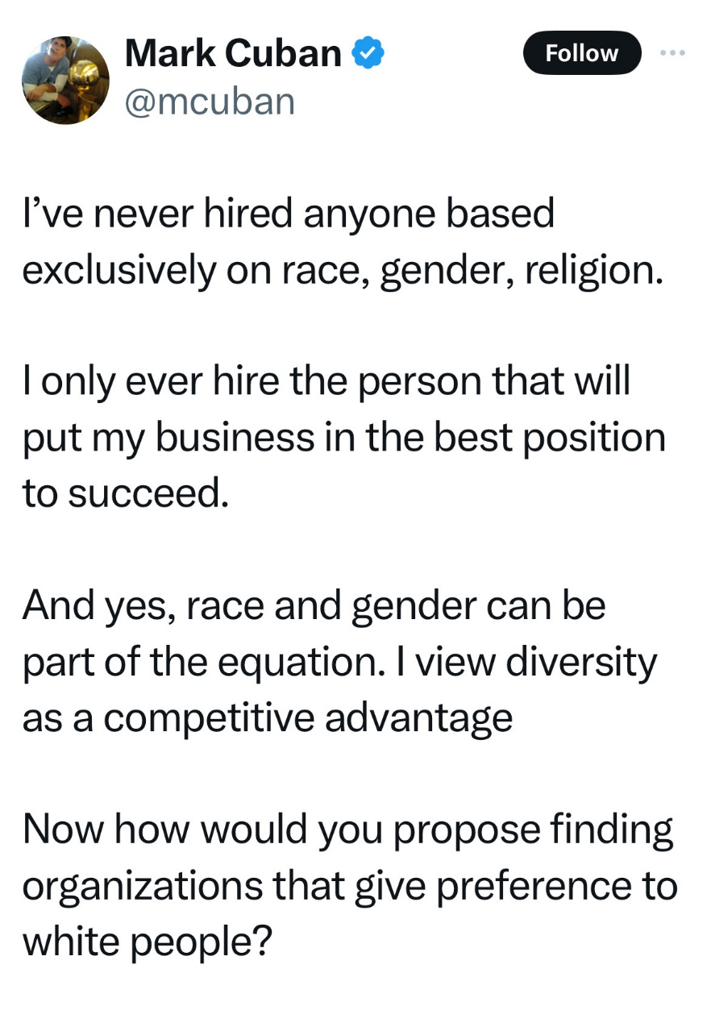
EMPLOYMENT INITIATIVES & LEGISLATION

Slide 8
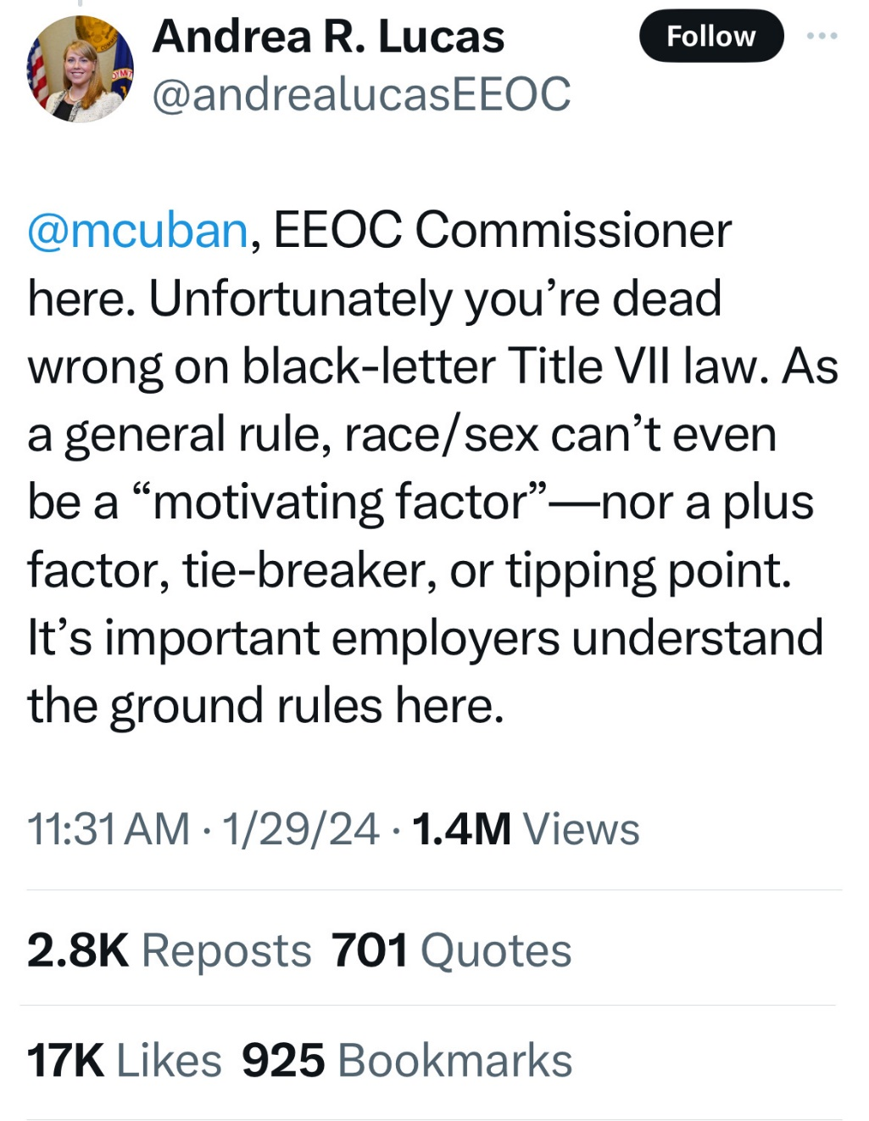
EMPLOYMENT INITIATIVES & LEGISLATION

Slide 9
Immigration implications for employers
Employers Have Been Lulled Into Lax Immigration Compliance
  Prior administration rarely raided or audited workplaces unless immigrant workers were perceived to be exploited
  State and federal agencies have had a lack of cooperation
  Federal agencies have thwarted other state efforts to police immigration compliance
ICE Focus on Violent Offenders
  Lots of collateral arrests in the orbit of violent offenders
  Raids of metropolitan areas, industry hubs, likely to continue

Slide 10
Immigration implications for employers cont’d
Return to Immigration Compliance
  Self-audit I-9 compliance
  E-Verify (where applicable)
  Are your documents accurate, accessible?
  Do employee IDs pass the “smell test”?
  How do you respond to Social Security “no match” letters?

Slide 11
Immigration implications for employers
Presidential Proclamation of September 21 – H-1B Visas
  Any new H-1B Application must include the one-time payment of a $100,000 issuance fee
  Increased issuance fee is not applicable to renewals or current visa holders
  New fee will be applicable to new applications in the up-coming FY2027 H-1B lottery cycle (generally March 2026)
  New lottery will favor applications for higher wages/skills over a purely randomized lottery
  Initial concerns that plain language of proclamation could have restricted re-entry to US by current H-1B visa holders without paying the fee. Administration has clarified no such application of the new fee
  Legislation to sunset H-1Bs

Slide 12
NLRB Changes
Biden NLRB was most active/aggressive in our lifetime
Trump NLRB is likely to moderate, but wholesale repudiation seems unlikely
There are 5 Board seats and Board only obtained a sufficient number of confirmed members to have a quorum now, in January 2026, after the Senate confirmed James D. Murphy and Scott Mayer
This gives the Board three members along with David Prouty, confirmed under President Biden
In January 2025, President Trump fired NLRB Member Gwynne Wilcox, which left the Board with only two active members for all of 2025
Although Wilcox sued, the Supreme Court allowed her termination to stand while her litigation continued, and the DC Circuit ultimately ruled that the NLRB’s purported independence from the Executive Branch was unconstitutional, upholding Trump’s firing of Wilcox

Slide 13
NLRB Changes
Most of the Biden NLRB agenda was driven by its Acting General Counsel Jennifer Abruzzo
President Trump fired Abruzzo in January, resulting in a round of musical chairs for the Acting General Counsel position
William Cowen, the former Regional Director for Region 21 (Los Angeles, CA), served in the role for the remainder of 2026
President Trump formally nominated Crystal S. Carey, an experienced management-side labor lawyer, to hold the General Counsel position, and the Senate finally confirmed that nomination in December 2025
Carey is expected to be more employer-friendly, but she has made no significant policy statements so far

Slide 14
NLRB Changes
Secretary Lori Chavez-DeRemer Proposes New Regulation Under the Labor Management Reporting and Disclosure Act of 1959
  First sign of Secretary Chavez-De-Remer catering to unions
  Proposed last July, the new rule would raise the $ value of annual receipts by a union from $250k to $450k before the union is obligated to file annual LM-2 financial reports
  LM-2s are a valuable tool for the public to hold unions accountable
    Detailed revenues, expenditures, salaries, lobbying, etc.
  Projected to reduce by 18% the number of LM-2 filers (~868 current union filers)
  Public comment period on the proposed rule closed on July 31, 2025, and the Department is considering public comments before issuing a final rule, expected sometime this year

Slide 15
Is the NLRB unconstitutional?
SpaceX v. NLRB
  At issue: NLRB members may only be removed by the President for good cause (i.e., only “for neglect of duty or malfeasance in office”), but not for inefficiency or other reasons
  NLRB ALJs are appointed by the NLRB, and their removal requires the NLRB to initiate an action before the Merit Systems Protection Board (“MSPB”), which is an independent federal agency. The MSPB must find good cause to remove ALJs. Furthermore, MSPB members themselves can be removed only for good cause.
  5th Circuit Holding:
    The NLRB’s limitations on the removal of Board members and ALJs is an unconstitutional impediment to the Executive’s exercise of its constitutional authority
    NLRB enforcement actions against the plaintiffs are enjoined
    The NLRB chose not to appeal the ruling—attempting to avoid sending the matter up to the Supreme Court
    SCOTUS is currently considering an opinion in Trump v. Slaughter that may overturn the ruling in Humphrey’s Executor, holding that Executive Branch agencies cannot be immune to or independent from personnel actions by the Executive

Slide 16
Return of us dol’s paid program
Payroll Audit Independent Determination Program (PAID)
  Under Trump 1.0, the U.S. Department of Labor implanted the PAID program as an approved method for employers to self-audit and correct FLSA compliance mistakes
  The Biden DOL terminated the program
  Effective July 2025, DOL has re-opened the program
  Employers may self-audit and then propose their findings and corrections (backpay) to the DOL’s Wage and Hour Division
  Remedies for self-correction result in a waiver of civil penalties, liquidated damages, and certain litigation risks
  2025 reauthorization of PAID has been expanded to FMLA self-corrections

Slide 17
Ob3 – no taxes on tips
Effective retroactive to the 2025 tax year, but scheduled to expire in 2028 unless earlier reauthorized
Deduction for “qualified tips” of up to $25,000 per year
Deduction phases out for individuals with “modified adjusted gross income” (“MAGI”) above $150,000 ($300,000 for joint filers)
  Phased out by $100 for each $1,000 of MAGI earned over the $150,000 threshold
Tips may remain subject to taxation at the state level in accordance with state laws unaffected by the Act
Includes provisions designed to limit tax benefit to individuals in occupations that are “customarily and regularly” tipped

Slide 18
Ob3 – no taxes on tips
Must have an occupation that is “customarily and regularly” tipped prior to December 31, 2024
  Treasury has issued regulations with list of occupations, “Treasury Tipped Occupation Codes”
Deduction disallowed if the tips were earned in:
  Professional occupations (e.g., health, law, accounting, actuary, performing arts, consulting, athletics, financial or brokerage services),
  Trades or businesses in which earners primarily trades on their reputation or skill, and
  Investment-related occupations
Where earner performs services personally, as a business owner and not an employee, deduction is capped at earner’s gross income from performing the services

Slide 19
Ob3 – no taxes on tips
Tips must be “qualified”:
  Must be voluntary, not subject to a negotiation between the earner and payor, and determined exclusively by the payor
  Mandatory tips, such as service charges for large parties at restaurants, and other service fees or administrative charges, are not considered “qualified” tips
  Must be cash or cash-like, including tips paid by credit or debit cards and tips distributed through a qualified tip pool
No change to existing process for the reporting tip income on W-2s or IRS Form 4137
  To be a qualified tip, the tip must be reported to the IRS, and eligible taxpayers must include their SSNs on their tax returns

Slide 20
Ob3 – no taxes on overtime
Effective retroactive to the 2025 tax year (but scheduled to expire in 2028 unless earlier reauthorized)
Deduction for “qualified overtime compensation” of up to $12,500 per year ($25,000 for joint filers)
Deduction phases out for individuals with MAGI above $150,000 ($300,000 for joint filers)
  Phased out by $100 for each $1,000 of MAGI earned over the $150,000 threshold
Overtime mill remain subject to taxation at the state level in accordance with state laws unaffected by the Act
Like the deduction for qualified tips, the deduction for “qualified overtime compensation” requires accurate W-2 reporting
  Requires that employers distinguish on the W-2s which overtime pay is qualified for the deduction

Slide 21
Ob3 – no taxes on overtime
Only overtime compensation explicitly required under the federal Fair Labor Standards Act (“FLSA”) will qualify for the deduction
  Requires understanding of the FLSA “regular rate of pay”
Overtime paid voluntarily, whether as a bonus or otherwise, paid pursuant to a contract (such as a collective bargaining agreement), by policy (including shift differentials and the like), or pursuant to a state or local law requiring overtime greater than that required by the FLSA, is not eligible for the deduction
The Act also specifies that a “qualified tip” may not also be claimed as “qualified overtime compensation”

Slide 22
Ob3 – practical wage/hour considerations
Expect questions from employees as tax filing season kicks off
Considerations for all employers:
  May want to consider more aggressively pushing voluntary or mandatory overtime for FLSA non-exempt employees or considering ways to expand eligibility for overtime deductions
    E.g., revisit salaried exempt FLSA classifications—particularly those that are close to the FLSA’s minimum salary level—to reclassify employees as non-exempt and provide more “qualified overtime compensation.”
  Examine best ways to ensure accurate payroll reporting of “qualified overtime compensation” on W-2s
Additional consideration for employers with jobs eligible for tips:
  May be worthwhile to consider more aggressively recommending tips to customers, or ways to expand or enhance qualified tip pools

Slide 23
Ob3 – telemedicine safe harbor
The Telemedicine HSA-eligibility safe harbor is now permanent
  Before the Act was passed, the prior temporary safe harbor, which allowed employers to provide telemedicine at no cost to employees without disqualifying them from HSA eligibility, expired at the end of 2024
High-deductible health plans (“HDHPs”) can now cover telemedicine and other remote care services before the minimum HDHP deductible is satisfied without losing HDHP status / HSA-eligibility
New permanent safe harbor is retroactively effective for plan years beginning after December 31, 2024
  Retroactive effectivity closes any gap that might have existed when previous temporary safe harbor expired

Slide 24
Ob3 – student loan reimbursements
Under Code § 127(a), “educational assistance” provided under employer’s qualified educational assistance program is excluded from employee’s income up to $5,250 per year
Act also allows employers to reimburse employees up to $5,250 per year for student loan payments tax-free to employees
  Makes permanent temporary provisions implemented under the Coronavirus Aid, Relief, and Economic Security Act (CARES) Act in 2020, where were set to expire at the end of 2025
Additionally, going forward, the $5,250 per year cap will be adjusted annually for inflation

Slide 25
Ob3 – dependent care assistance programs
Act increases the maximum amount of benefits that can be excluded from income under a Dependent Care Assistance Program (“DCAP”) from $5,000 to $7,500 (from $2,500 to $3,750 for taxpayers who are married filing separately)
  Dependent care tax credit (“DCTC”) has also been enhanced
The DCAP and DCTC changes apply to tax years beginning after 2025
Changes have also been made to the child tax credit
and other tax provisions that may be relevant when determining the federal tax savings from participating
in a DCAP vs. claiming the DCTC
Act also enhances the credit available to employers that provide childcare services to employees

Slide 26
Federal contractor compliance changes
End of Women & Minority Affirmative Action Plans
  Executive Order 14173 “Ending Illegal Discrimination and Restoring Merit Based Opportunity” eliminated all obligations under Executive Order 11246, including OFCCP regulations
    Race and Gender Self-Identification Upon Application
    Action Oriented Programs and Outreach
    Affirmative Action Plans
    Adverse Impact Analysis
    Compensation Analysis
  Obligations Under the VEVRAA and Section 503 of the Rehabilitation Act Remain:
    Disabled/Vets Voluntary Self Identification
    Veterans and IWD Affirmative Action Plans
    Listing of Job Openings with state listing service
    Vets 4212 Filing

Slide 27
Federal contractor compliance changes
OFCCP Proposes Rules to Further Reduce Affirmative Action Obligations (July 1, 2025)
  Proposed Rules Would:
    Eliminate the obligation to invite applicants and employees to self-identify as individuals with disabilities (but maintain the obligation to invite applicants to identify as veterans)
    Eliminate the utilization goal requirements for individuals with disabilities (now 7%)
    Leave in place the obligations under VEVRAA and Section 503 to engaged in outreach, recruitment activities geared toward veterans and the disabled, and continue to maintain affirmative action programs
    Public comment period expired September 2, 2025, and we await final regulations (likely in 2026)

Slide 28
Employee benefits litigation
Rising trend in litigation against employers alleging fiduciary duty violations
  Several associated with PBM and related contracts
Employers have a fiduciary obligation to act in the best interests of the participants in an employee benefit plan
Utilize well-informed industry experts, consultants, brokers, and actively vet plan options and associated costs

Slide 29
Matt Stiles
mstiles@maynardnexsen.com
Copyright 2026 Maynard Nexsen, P.C. All rights reserved. Reproduction or use of these materials, including for in-house training, without authorization of the authors is prohibited.

